Slide 1
Felony Murder Rule
If killing while committing another felony it will be considered murder.

Slide 2
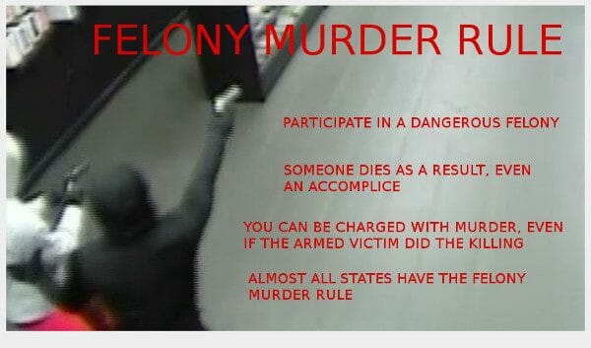

Slide 3
Capital Crimes
Crimes punishable by death
2 hearings
  One to determine the guilt or innocence
  One to sentence the individual

Slide 4
Does the death penalty deter crime?

Slide 5
Is the death penalty moral?
Is it actually justice?

Slide 6
Swift execution of the death penalty?

Slide 7
What role does it play?
Income
Race
Male/female
Age/mental incapacity

Slide 8
Guilty or Innocent?
Are innocent people executed?

Slide 9
“Abandon all hope you who enter here”

